Slide 1
Report on demands and costs for citywide diversion program Response to SLI HSD-006-A-003

Slide 2
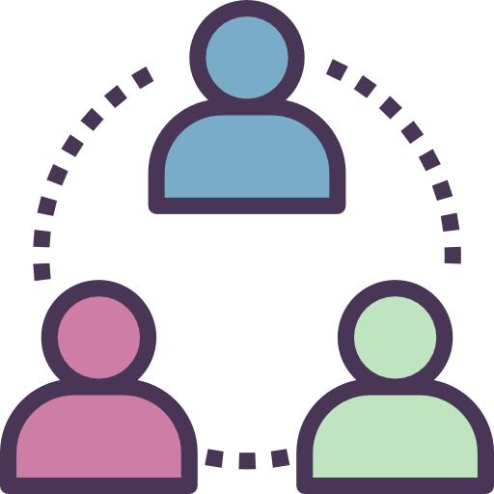
What Is LEAD
LEAD provides community-based care for people who commit law violations related to behavioral health issues or extreme poverty, as an alternative to punitive enforcement-based responses.
Individuals referred to LEAD receive immediate access to harm reduction-based intensive case-management, including – but not limited to – chemical dependency treatment, mental health care, legal system support, increasing financial independence, and referrals into shelter and permanent housing.

Slide 3
What Is LEAD
LEAD participants are those who commit, or are at high risk of committing, law violations related to their behavioral health challenges and/or income instability.
LEAD case management follows the harm reduction principle of taking the harm seriously – the central program goal is to reduce problematic and illegal behavior, and thereby to reduce the “police-ability” of individuals who have largely been rebuffed by care systems and exposed to enforcement and the legal system as a primary response for behavioral health conditions and income instability.

Slide 4
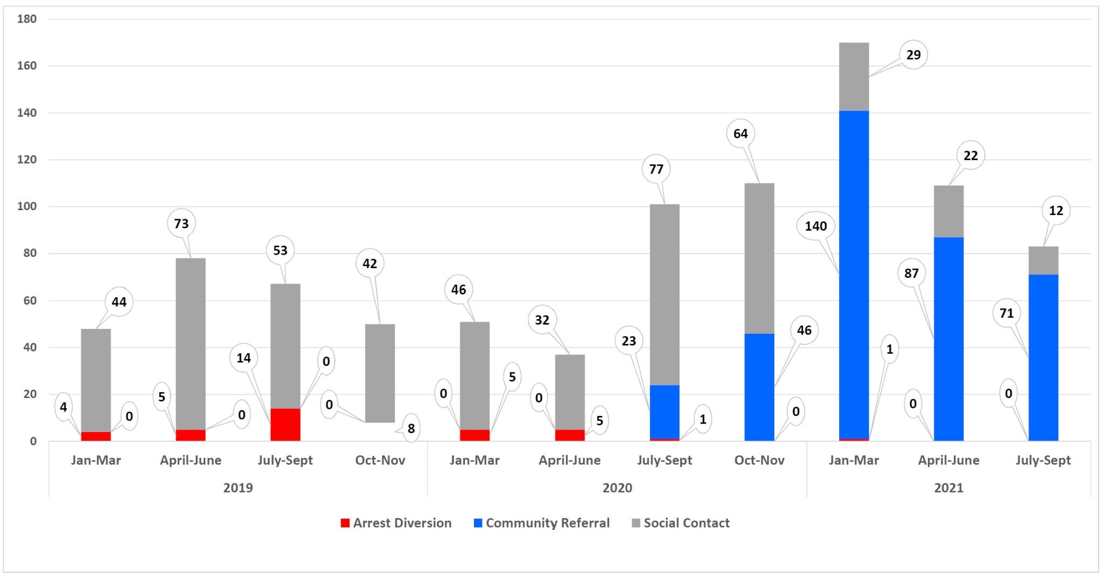
LEAD referrals 2019-YTD
YTD Approvals (Sep 2020 - Aug 2021): 347

Slide 5
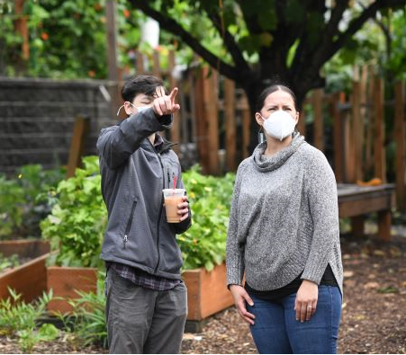
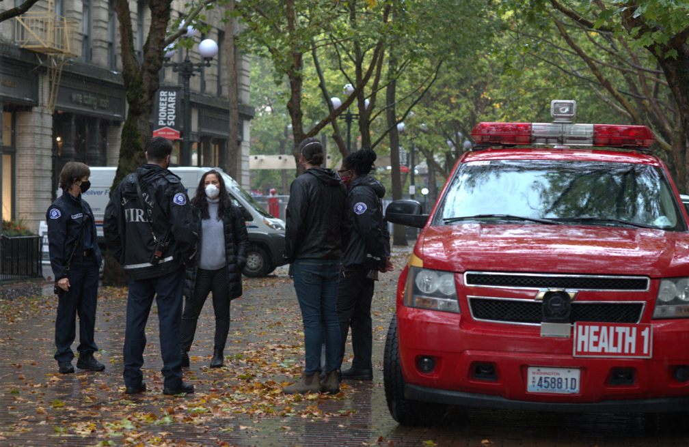
Community referral sources include:
REACH, ACRS, Co-LEAD, DESC
King County Department of Public Defense
King County Prosecuting Attorney
Seattle City Attorney
SFD Health One Community Passageways
Pioneer Square Alliance Downtown Seattle Association U District Partnership Ballard Alliance CID Public Safety Team City of Seattle
King County Public Health Port of Seattle
Self/Family/Friend Community residents
Other Social Service Orgs

Slide 6
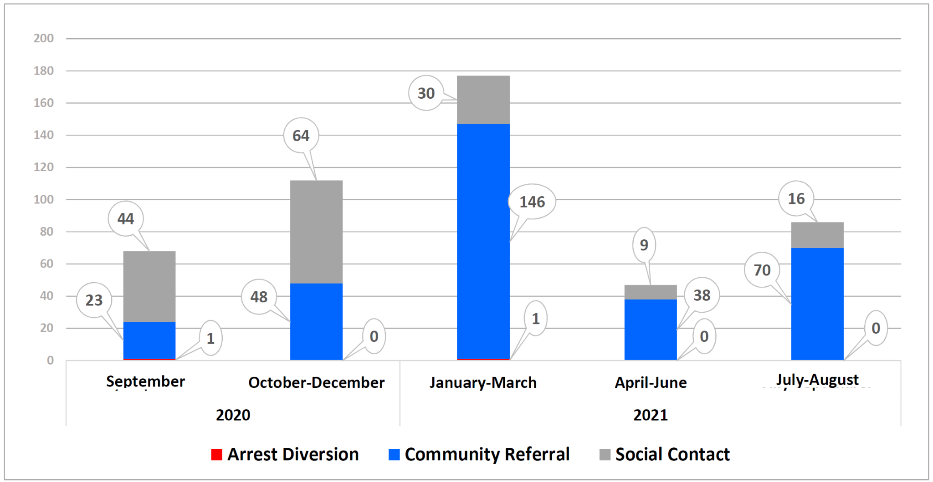
Who is in LEAD: referrals in past 12 months

Slide 7
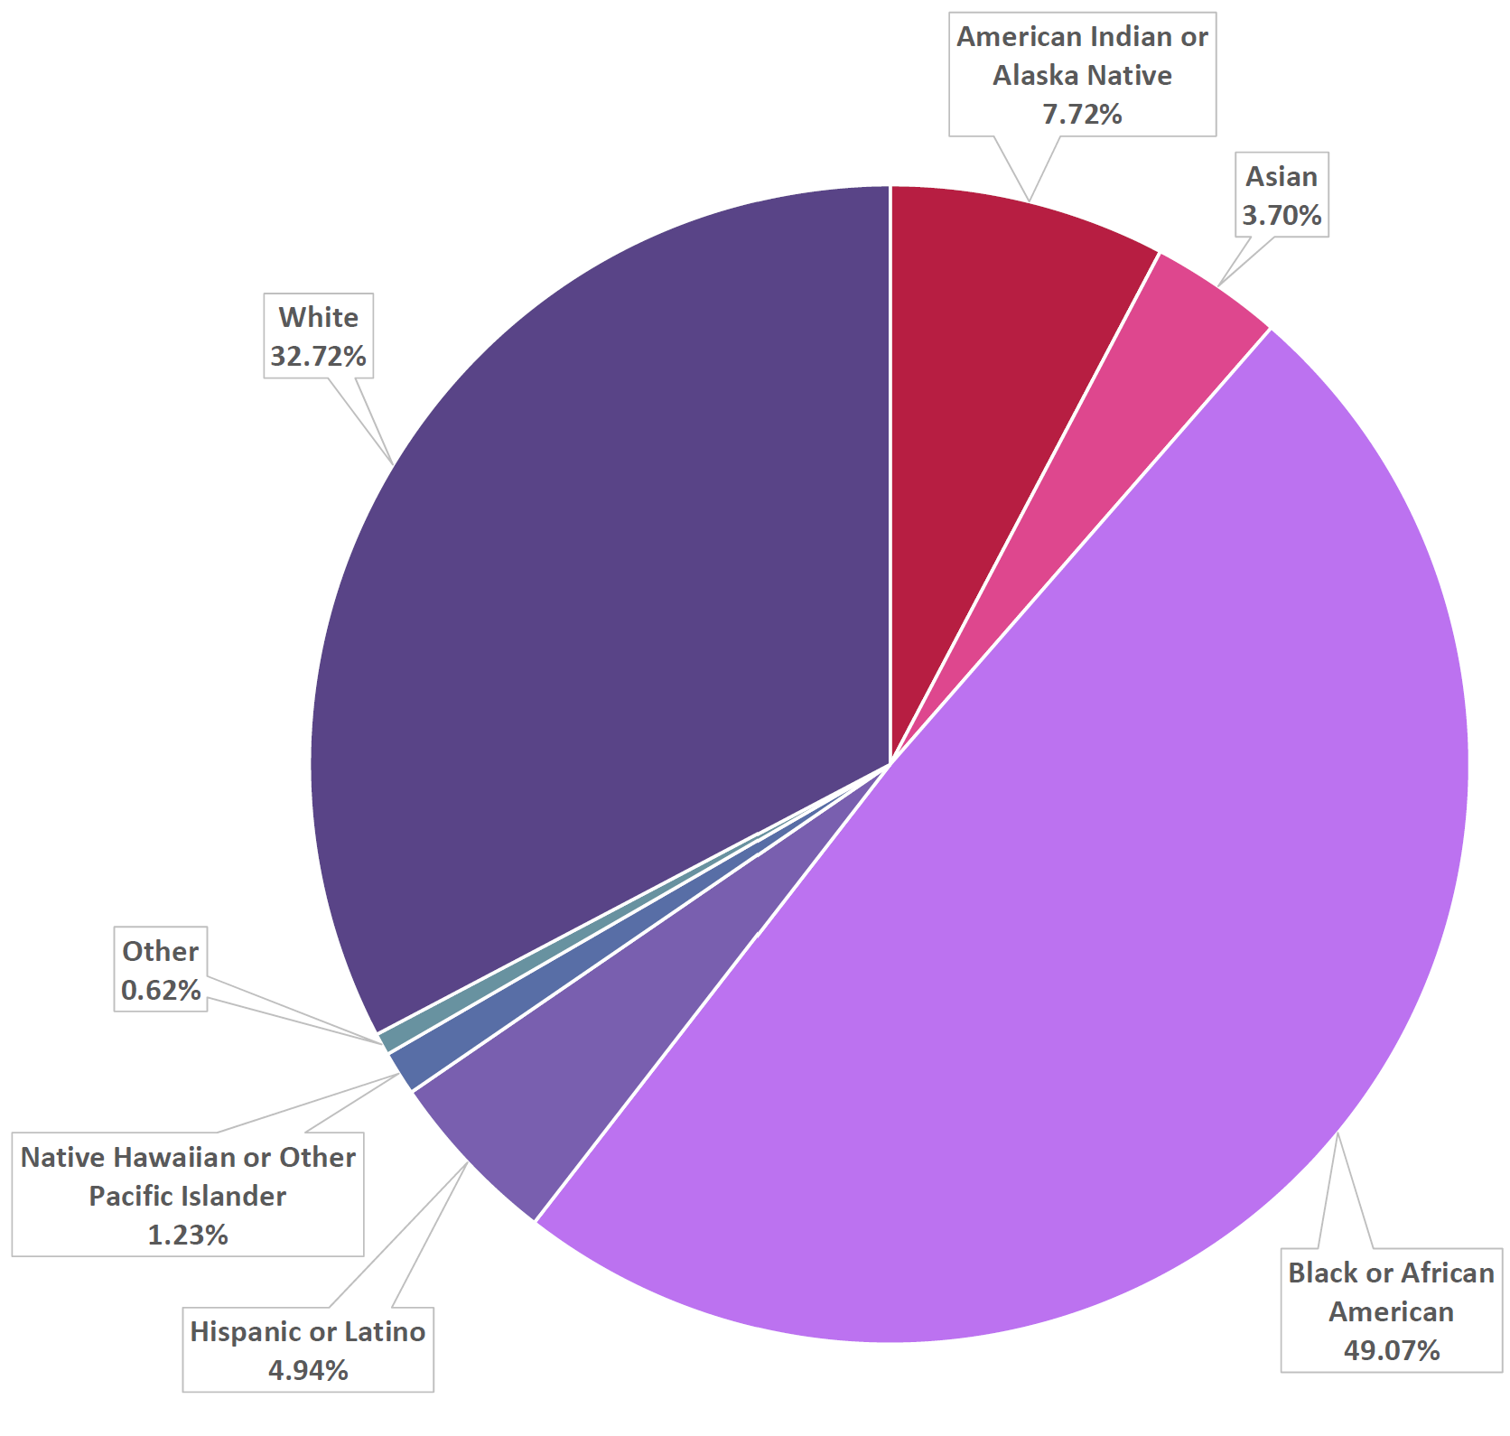
Approved Community Referrals by Demographic
49.07% Black/African-American
32.72% White
7.72% American Indian/Alaska Native
4.94% Latinx
1.23% Native Hawaiian or Other Pacific Islander
3.7% Asian
0.62% Other

Slide 8
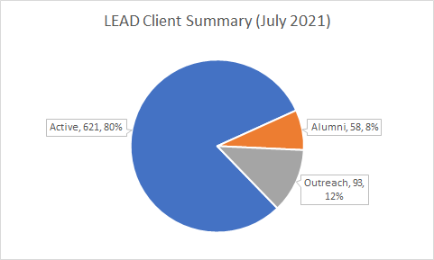
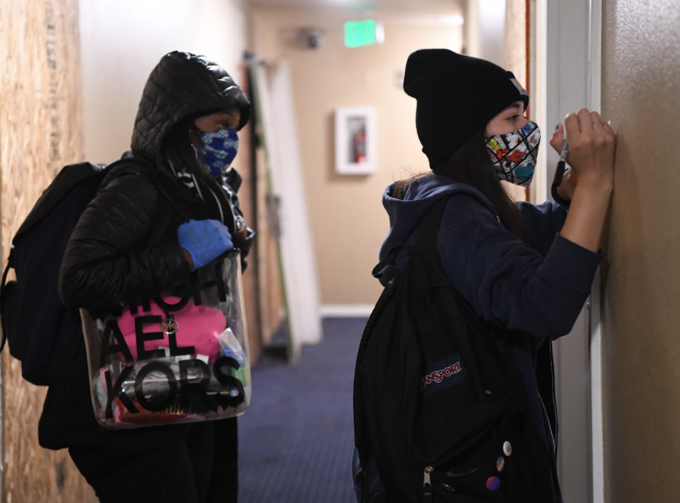

Slide 9
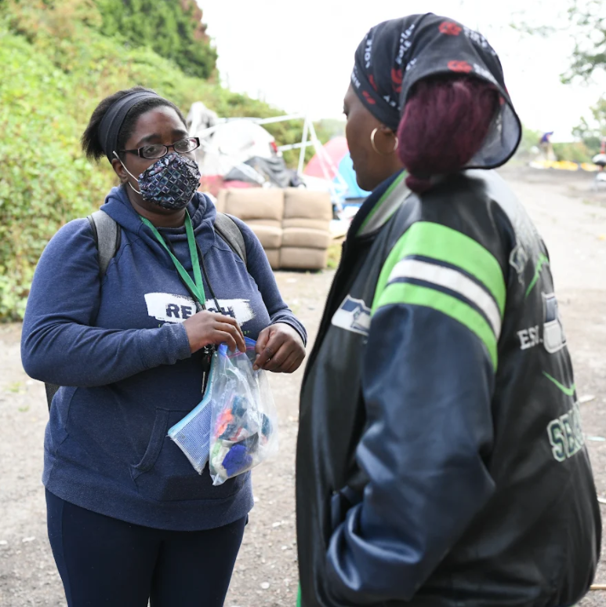
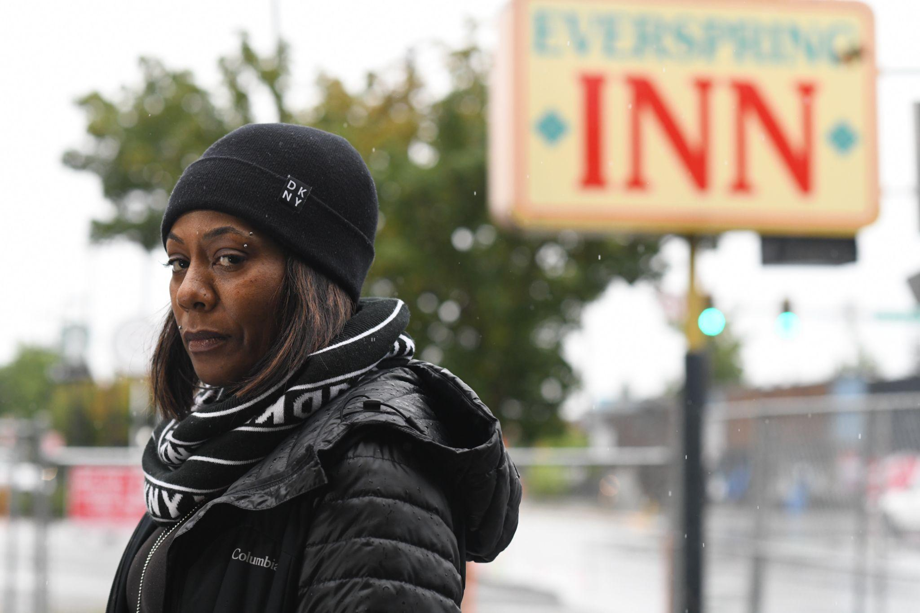
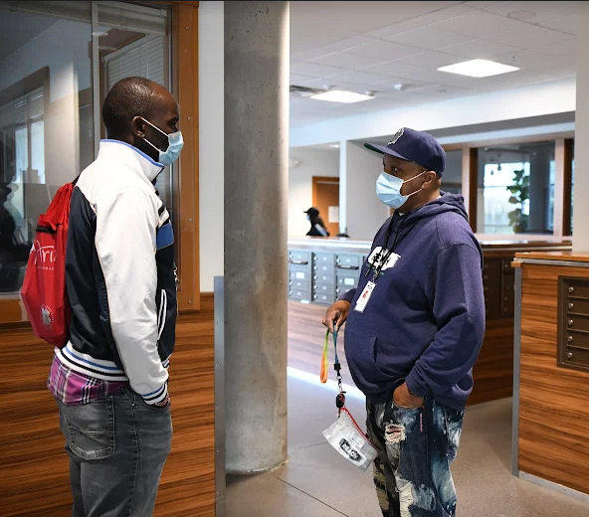
In 2019, City Council established a requirement that average caseloads are no more than 20 cases, with a maximum of 25 cases. LEAD case managers are in general once again far above that level. Intensive case management best practice caseload levels are 12-15 cases by comparison.
LEAD Case Manager Structure

Slide 10
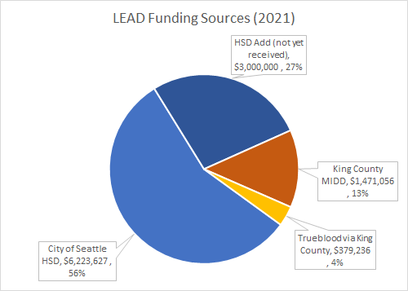
Revenue Source | Amount
City of Seattle HSD | $6,223,627
HSD Add (not yet received) | $3,000,000
King County MIDD | $1,471,056
Trueblood via King County | $379,236
Total | $11,073,919

Slide 11
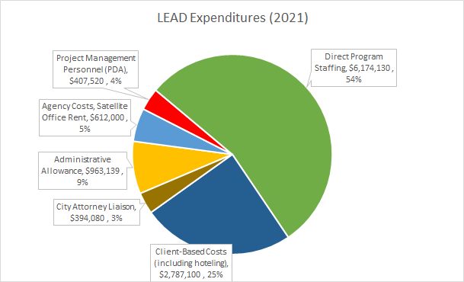
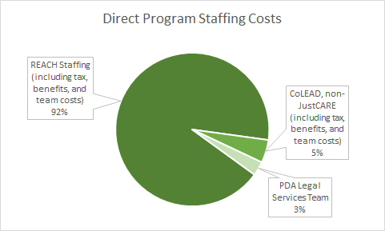

Slide 12
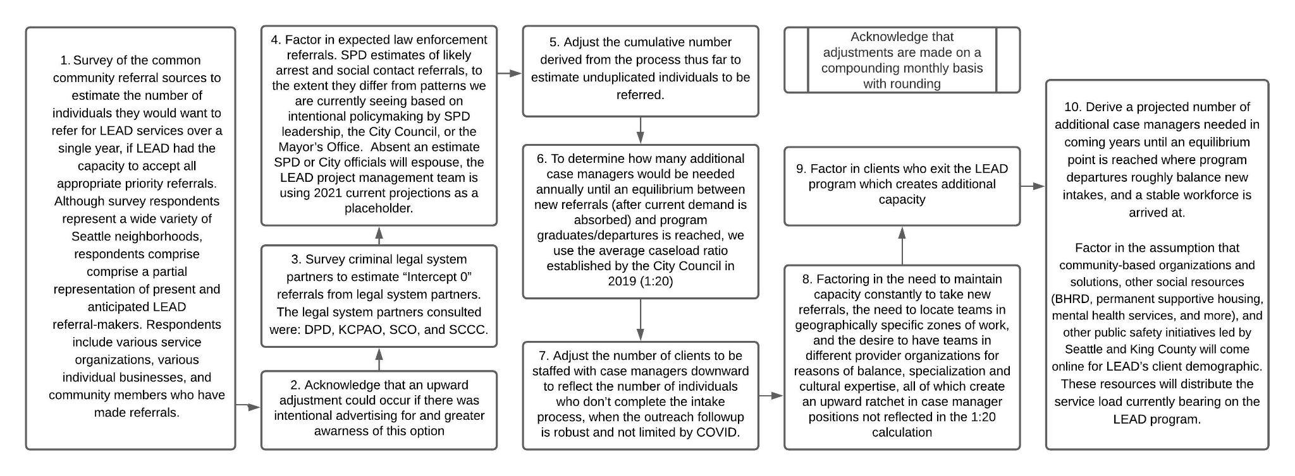
Process: Projecting Client and Case Manager Growth

Slide 13
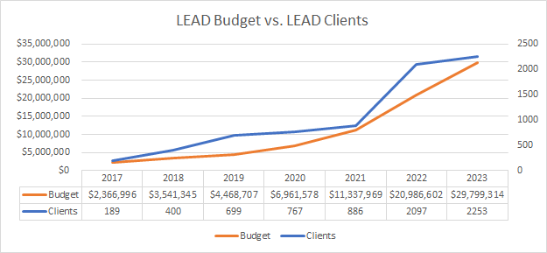
*Prior to December 2020,, LEAD client data relied on BHRD estimates of participants enrolled in the LEAD program, which draws on data from King County’s behavioral health information system. Starting in 2021, the project management team began using an updated, consistent protocol for categorizing the pool of LEAD referrals and LEAD clients in order to improve operational tracking, assess caseload capacity, and improve the referral / intake conversation ratio. As of 2021, 130 people have been exited from LEAD since program inception (2011) for a range of reasons, including being sent to prison, loss of contact, and becoming self-sustaining.

Slide 14
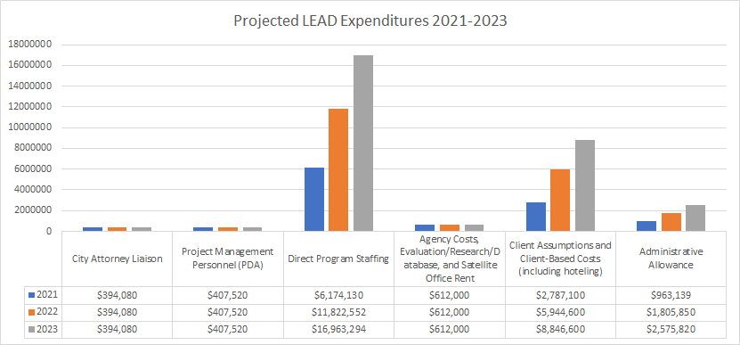
*This chart does not include over $600k annually for PAO liaison and BRHD contract administrator costs from the County. CAO costs are included in this chart.

Slide 15
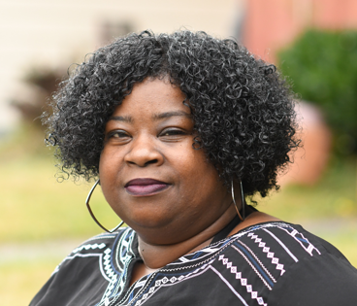
Tara Moss, Seattle-King County LEAD Project Director, Public Defender Association tara.moss@defender.org
Brandie Flood, Director of Community Justice, REACH brandief@etsreach.org
Devin Majkut, LEAD Program Supervisor, REACH devinm@etsreach.org
Lisa Daugaard, Director of Public Defender Association lisa.daugaard@defender.org
Tiarra Dearbone, LEAD Sr. Project Manager, Public Defender Association tiarra.dearbone@defender.org

